Slide 1
Our planet
By Alejandro tarrasa

Slide 2
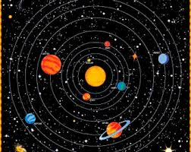
The solar system
Our planet is part of the solar system, which is formed by 8 planets that orbit the Sun. The Erth takes the 3rd place.

Slide 3
The Earth
Our planet is the fifth largest planet in the Solar System and the largest one of the rocky planets.
Its Surface is 510,1 km2, and it is 149,6 million km from the Sun.

Slide 4

Our planet
By Alejandro tarrasa

